Slide 1
Student spending habits
CAPSTONE PROJECT
Presented By:
Chelladurai K
9513- Jayaraj Annapackiam CSI College Of Engineering
B.E Mechanical Engineering

Slide 2
OUTLINE
Problem Statement
Proposed System/Solution
System Development Approach
Algorithm & Deployment
Result
Conclusion
Future Scope
References

Slide 3
Problem Statement
Many students struggle with managing their finances effectively, leading to financial stress, debt accumulation, and poor spending habits. Factors such as limited income, lack of financial literacy, peer influence, and impulse buying contribute to irresponsible spending behaviors among students. As a result, students may face difficulties in covering essential expenses, saving for the future, and achieving financial independence. There is a need to address these challenges by developing educational programs, tools, and resources that promote financial literacy, budgeting skills, responsible spending, and smart financial decision-making among students.

Slide 4
Proposed Solution
Financial Literacy Programs:
Implement comprehensive financial literacy programs within educational institutions, covering topics such as budgeting, saving, investing, debt management, and understanding financial products (e.g., credit cards, loans).
Offer workshops, seminars, and online courses conducted by financial experts or partnerships with financial institutions.
Budgeting Tools and Apps:
Provide students with access to budgeting tools and mobile apps that help track expenses, set financial goals, categorize spending, and monitor income and expenditures in real-time.
Include features such as expense reminders, savings goals, spending limits, and financial summaries to encourage accountability and informed decision-making.
Financial Literacy Workshops and Events:
Organize regular financial literacy workshops, events, and competitions on campus to promote financial awareness, engage students, and foster a culture of financial responsibility.
Invite guest speakers, alumni, and industry professionals to share insights, success stories, and practical tips on personal finance.
Social Media and Online Communities:
Leverage social media platforms and online communities to share financial tips, resources, success stories, and best practices among students.
Create student-led financial clubs or groups where members can discuss financial topics, exchange ideas, and support each other in achieving financial goals.

Slide 5
System Approach
Needs Assessment and Analysis:
Conduct a thorough needs assessment to understand the current spending habits, financial challenges, and knowledge gaps among students.
Analyze demographic data, student surveys, and financial behavior patterns to identify key areas for intervention and improvement.
Education and Awareness Programs:
Develop educational materials, workshops, seminars, and online resources to promote financial literacy, budgeting skills, and responsible spending habits among students.
Cover topics such as setting financial goals, creating budgets, managing debt, understanding credit, and making informed financial decisions.
Monitoring and Evaluation:
Establish metrics, benchmarks, and key performance indicators (KPIs) to measure the effectiveness of financial education programs and initiatives.
Conduct regular evaluations, surveys, and feedback sessions to gather insights, assess impact, and make data-driven improvements.
Continuous Improvement and Sustainability:
Foster a culture of continuous improvement by reviewing feedback, analyzing results, and adapting strategies to address evolving student needs and challenges.
Secure funding, resources, and institutional support to sustain long-term financial education initiatives and ensure ongoing student engagement and success.

Slide 6
Algorithm & Deployment
ALGORITHM FOR STUDENTS' SPENDING HABITS:
Data Collection and Analysis:
Collect demographic data, spending patterns, and financial behaviors of students through surveys, interviews, and analytics tools.
Analyze the data to identify trends, common spending pitfalls, and areas where students may need support or education.
Financial Education Curriculum:
Develop a structured financial education curriculum covering topics such as budgeting, saving, credit management, debt reduction, and financial goal setting.
Create interactive modules, quizzes, and learning materials to engage students and reinforce key concepts.
Budgeting and Tracking Tools:
Integrate budgeting and expense tracking tools into student portals, mobile apps, or online platforms.
Develop algorithms that categorize expenses, track spending trends, and provide personalized recommendations based on students' financial goals and behaviors.
Financial Counseling and Support Services:
Implement a system for students to access financial counseling services, workshops, and peer mentoring programs.
Develop algorithms to match students with financial advisors or mentors based on their specific needs and goals.

Slide 7
Deployment
Infrastructure Setup:
Set up a secure and scalable infrastructure for hosting financial education modules, budgeting tools, and student support services.
Choose cloud-based platforms or servers with robust security measures to protect students' financial information.
Application Development:
Develop web-based or mobile applications for delivering financial education content, budgeting tools, and access to support services.
Use agile development methodologies to iterate quickly, gather user feedback, and make continuous improvements.
Integration with Student Systems:
Integrate financial education modules and tools with existing student portals, learning management systems (LMS), and academic platforms.
Ensure seamless data flow and synchronization between financial tools, student databases, and counseling services.
Training and Onboarding:
Train faculty, staff, and advisors on how to use the financial education tools, counseling resources, and incentive systems effectively.
Provide onboarding sessions for students to familiarize them with the platform, features, and benefits of participating in financial education programs.

Slide 8
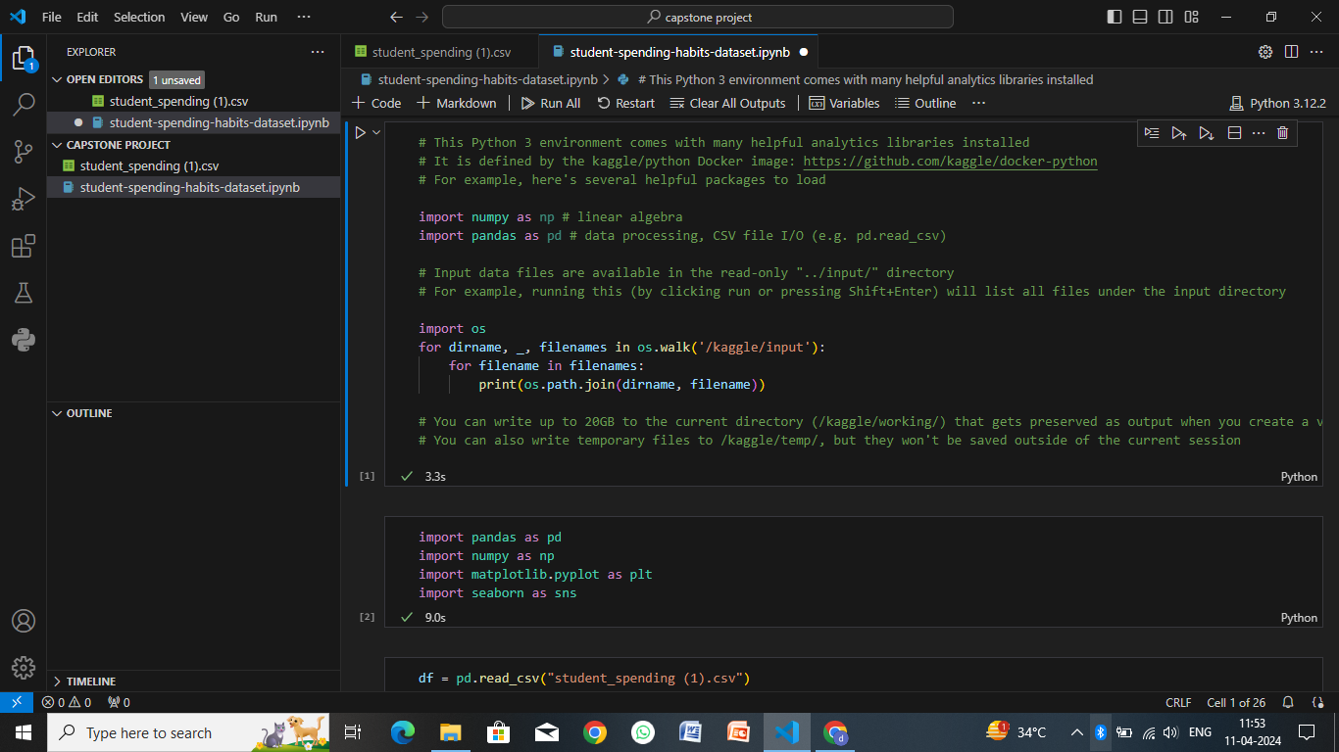
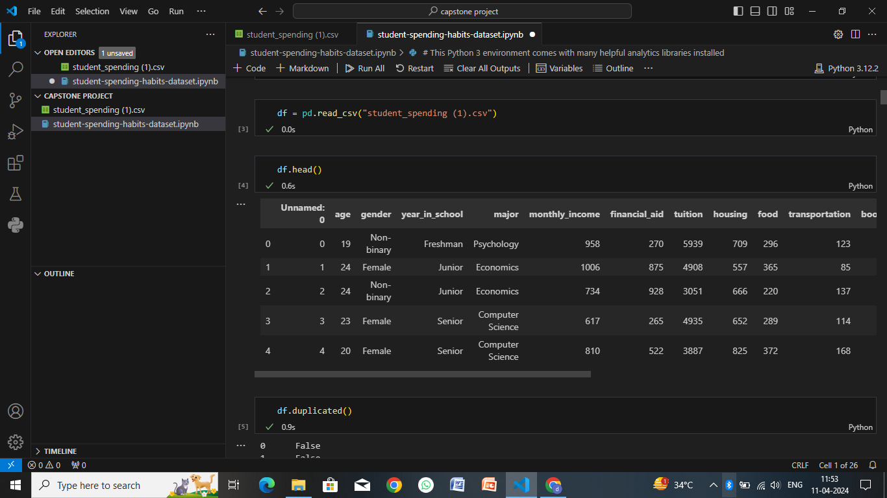
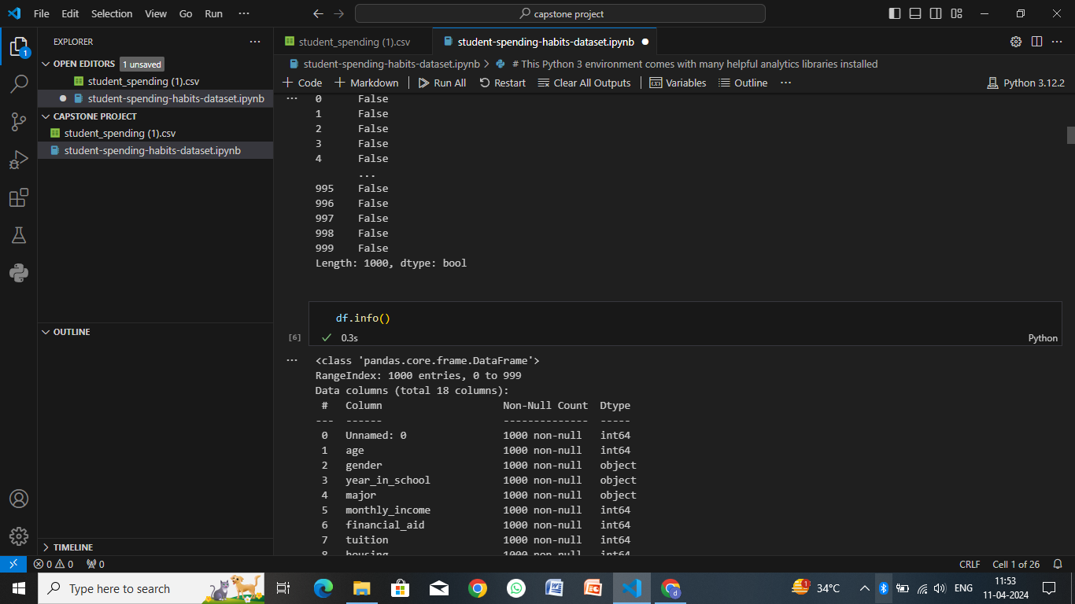
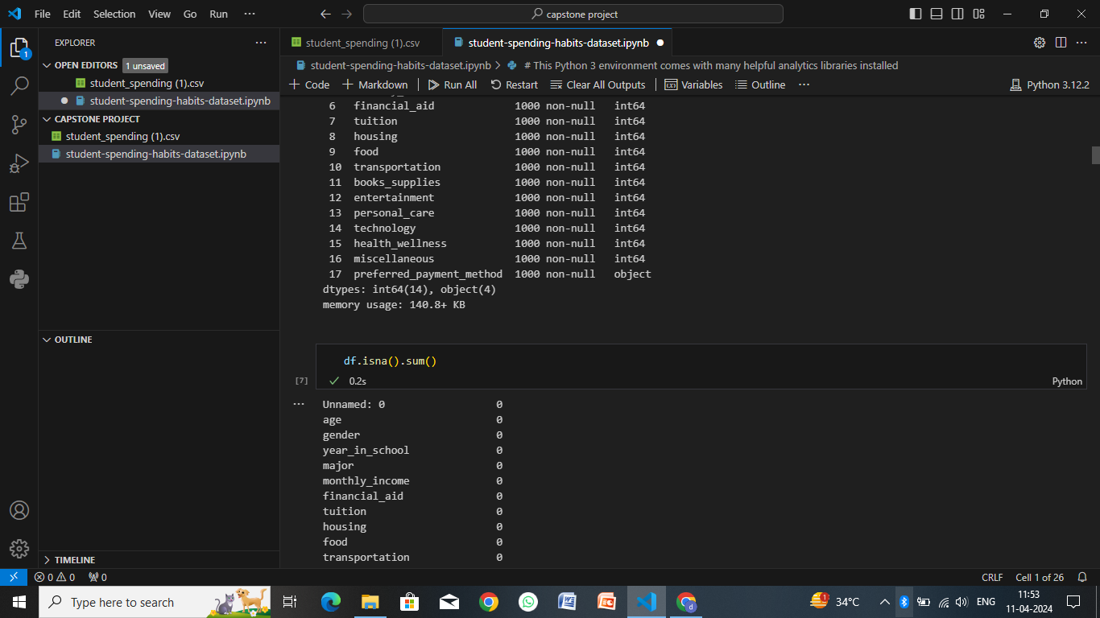
Result

Slide 9
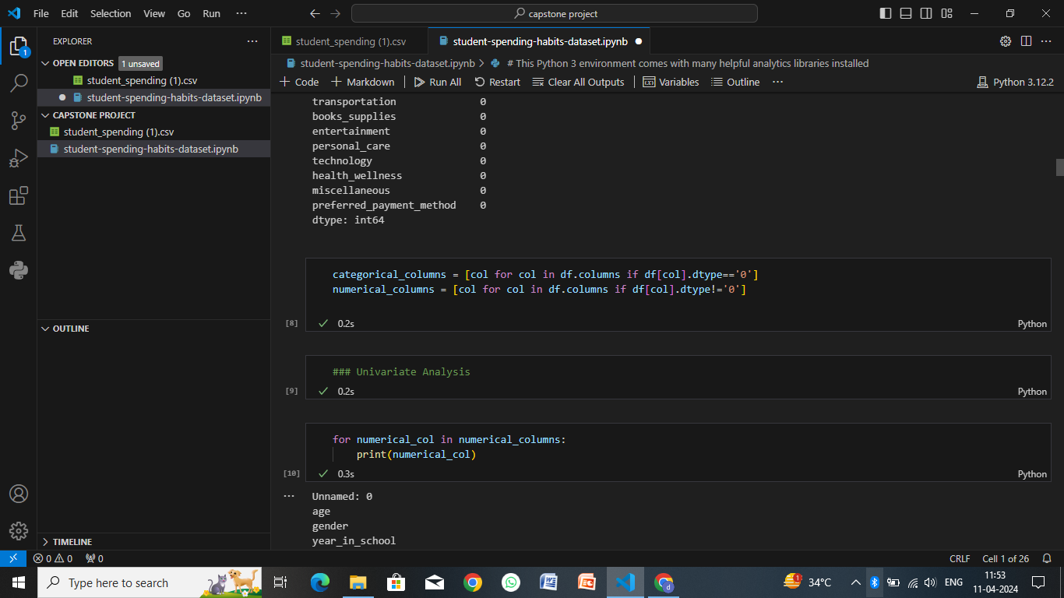
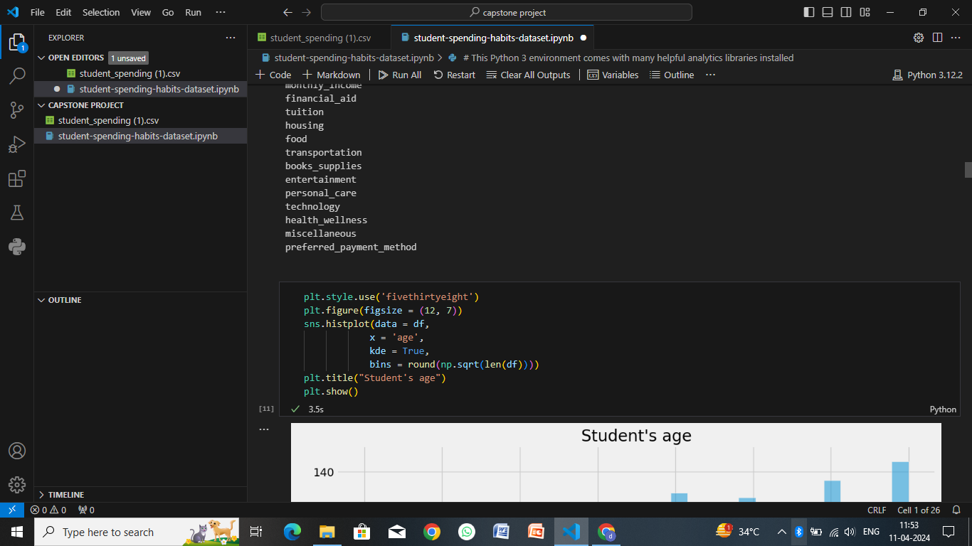
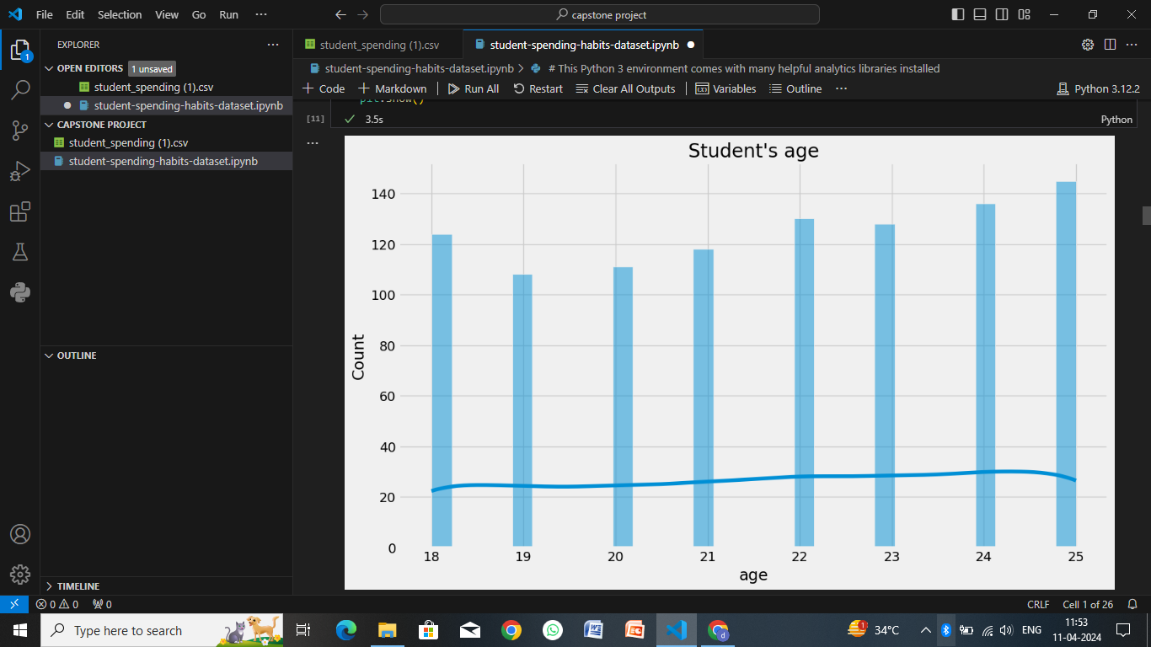
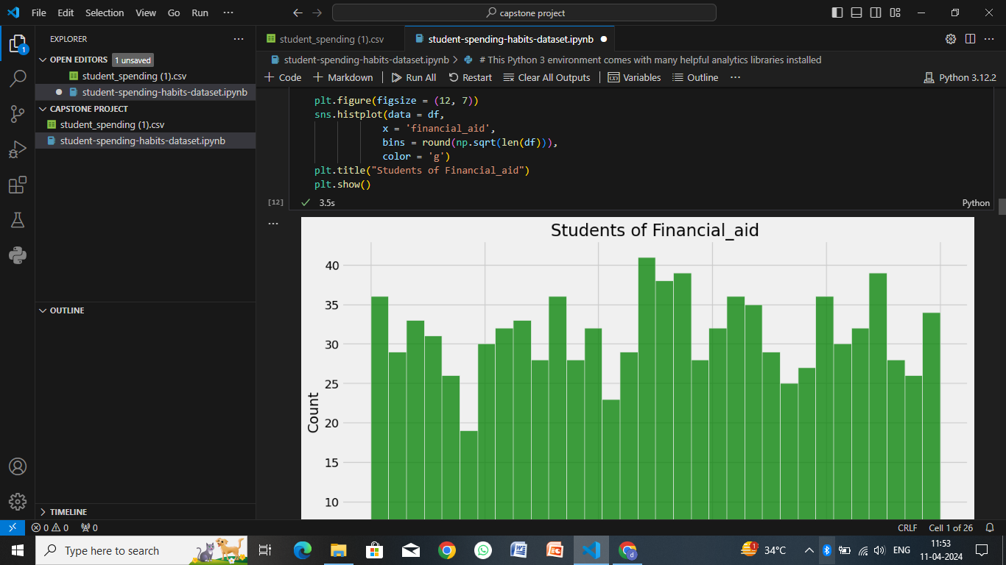

Slide 10
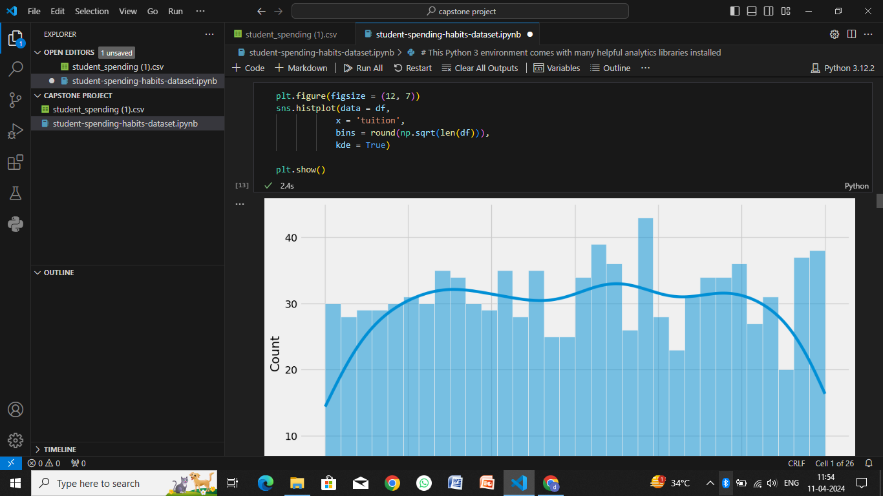
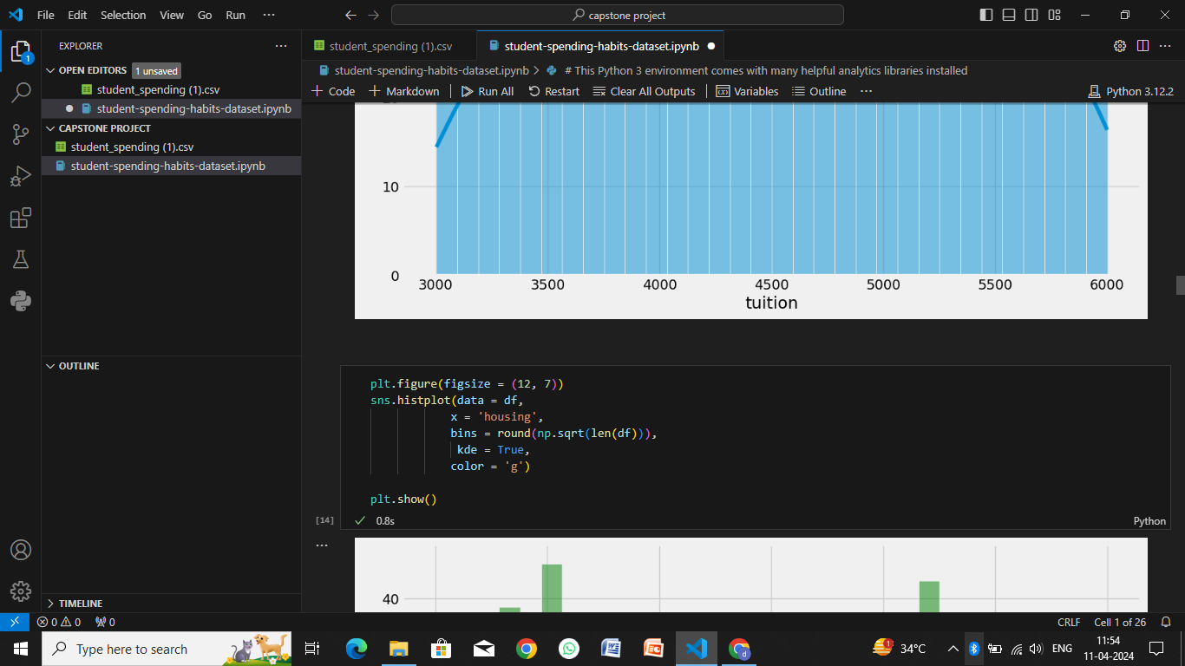
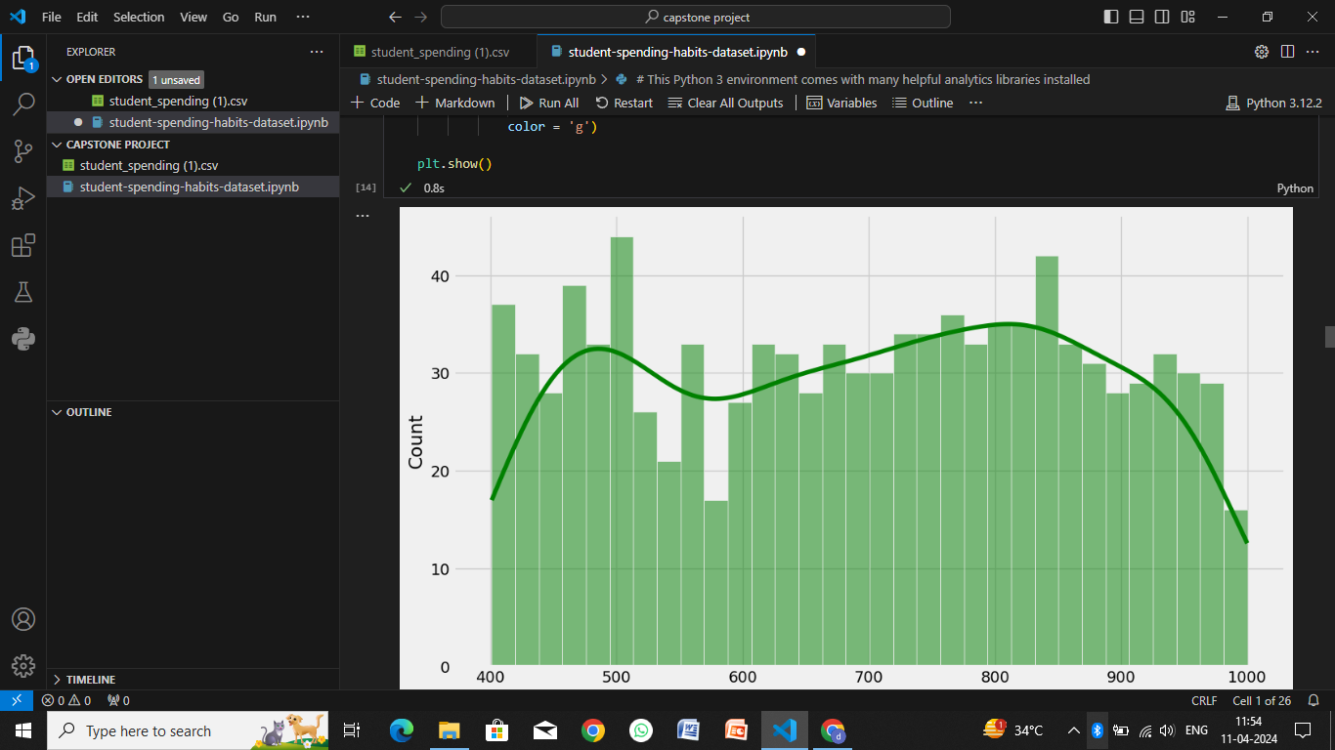
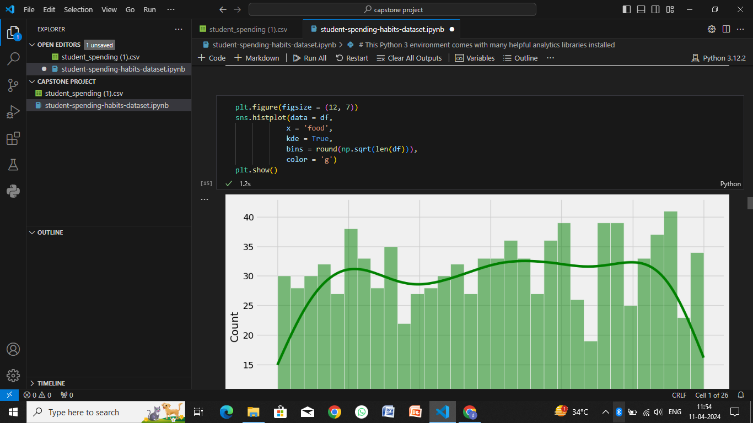

Slide 11
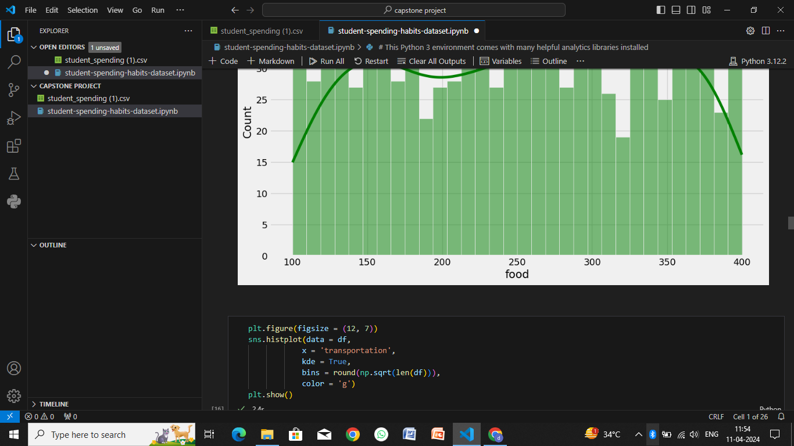
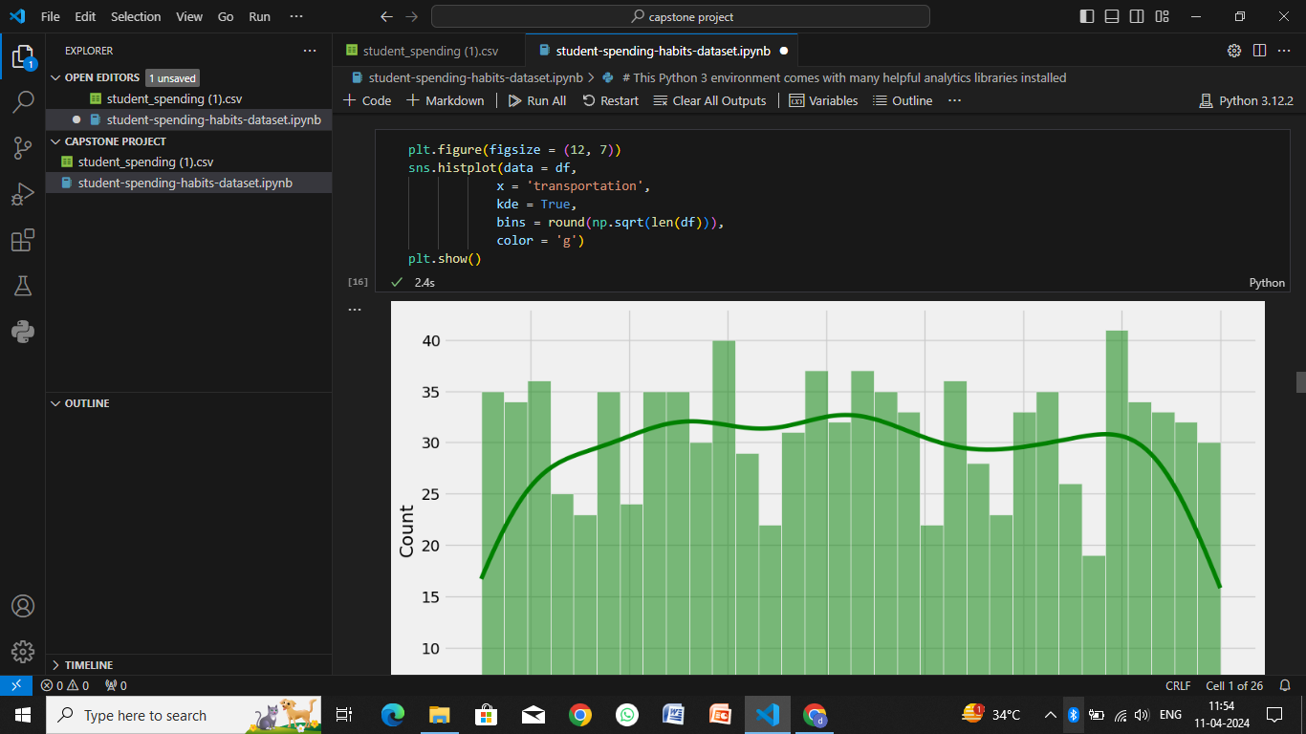
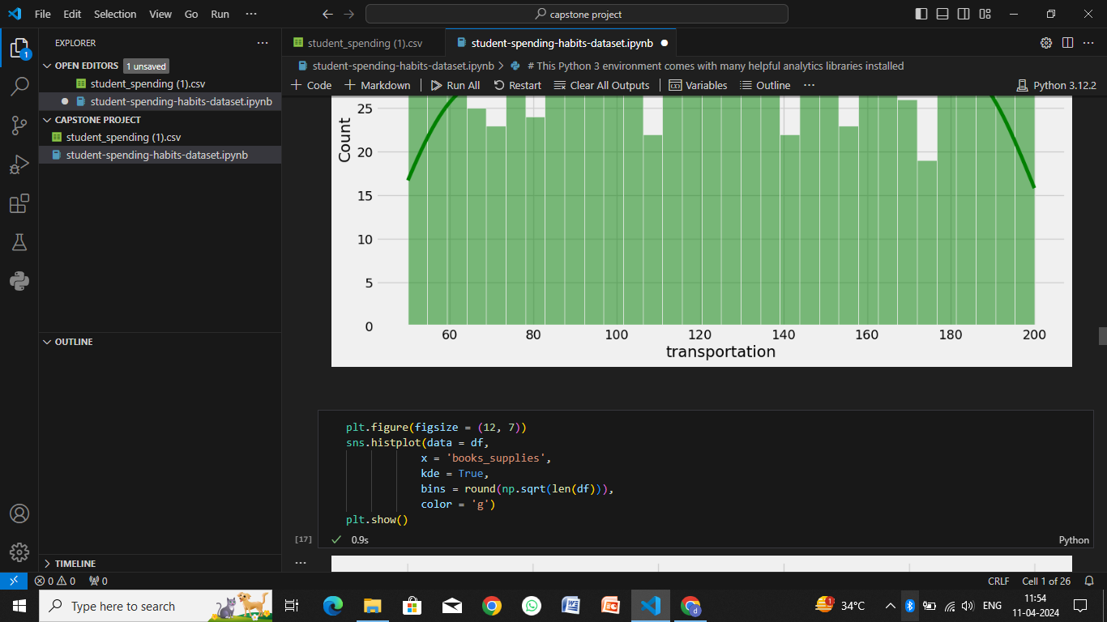
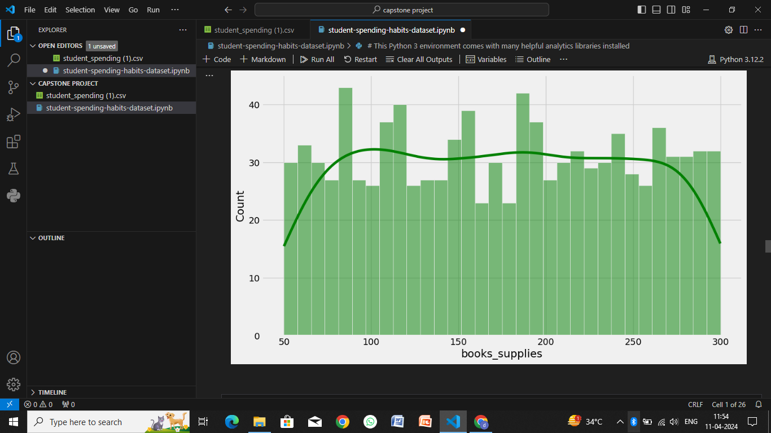

Slide 12
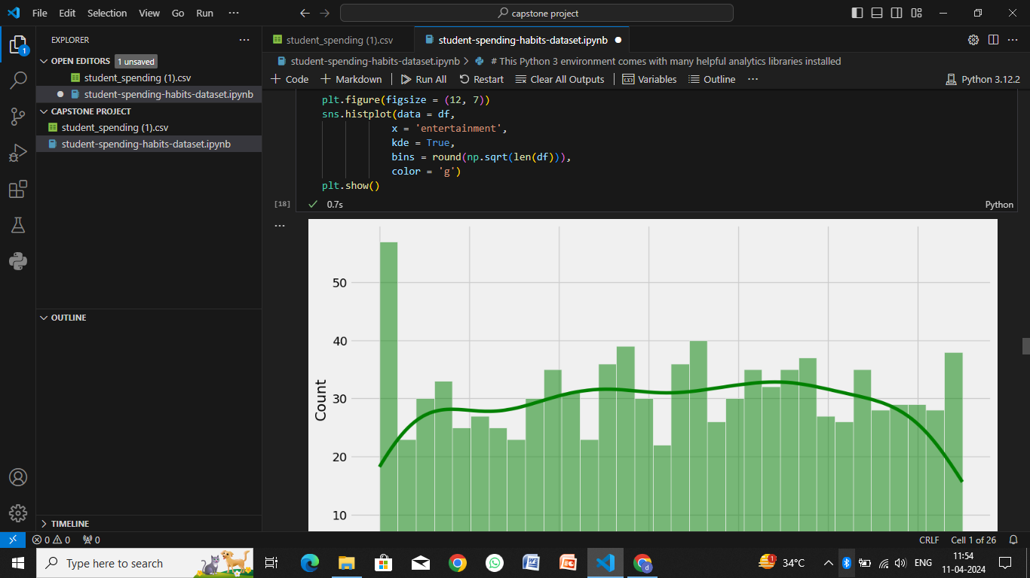
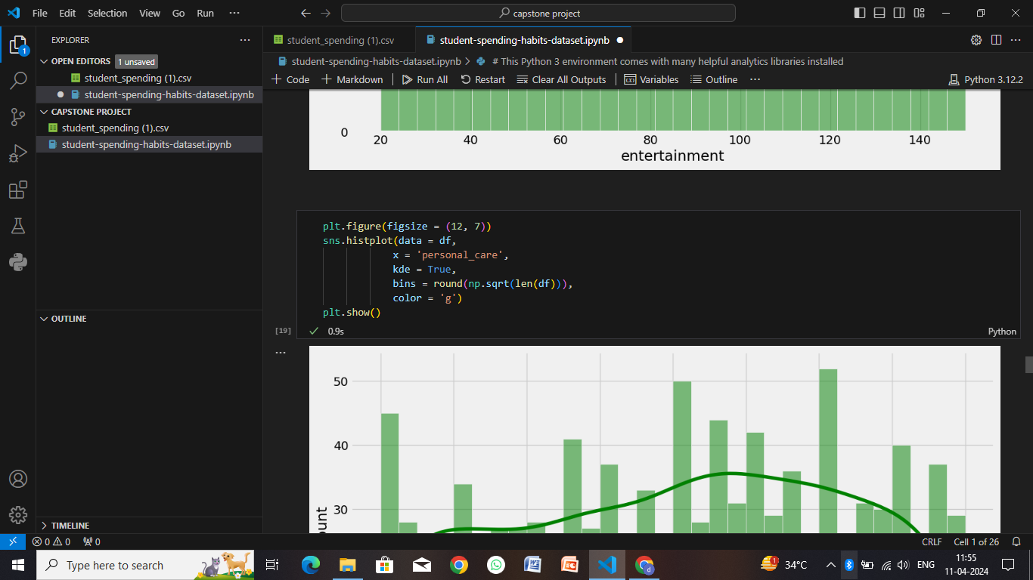
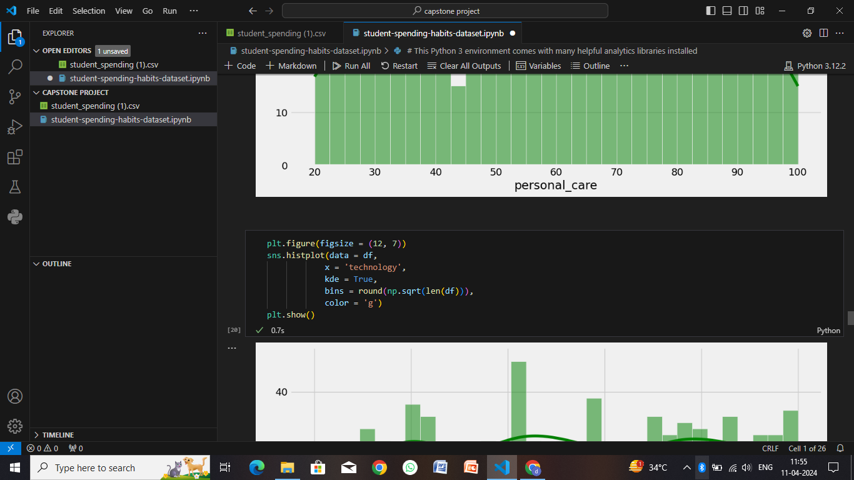
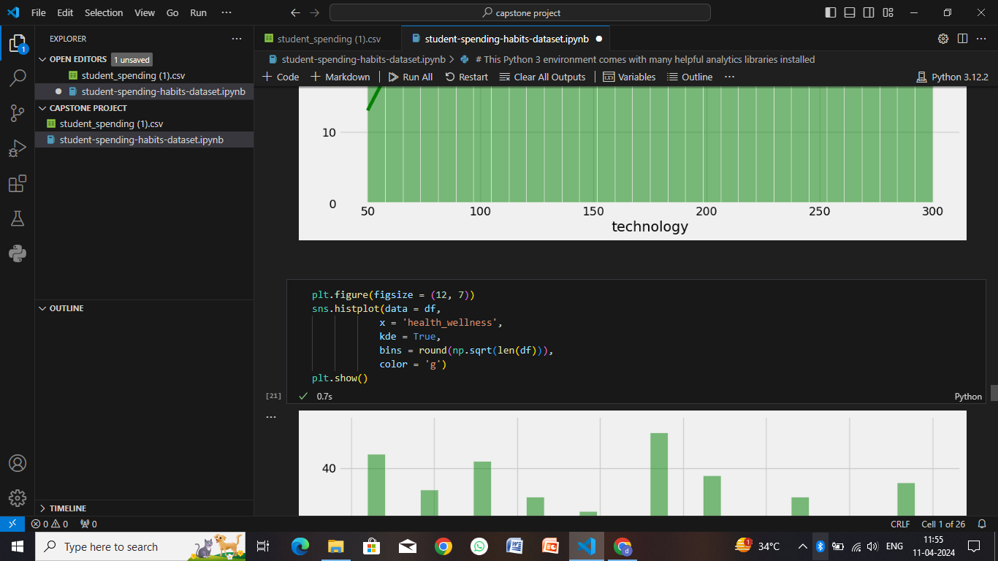

Slide 13
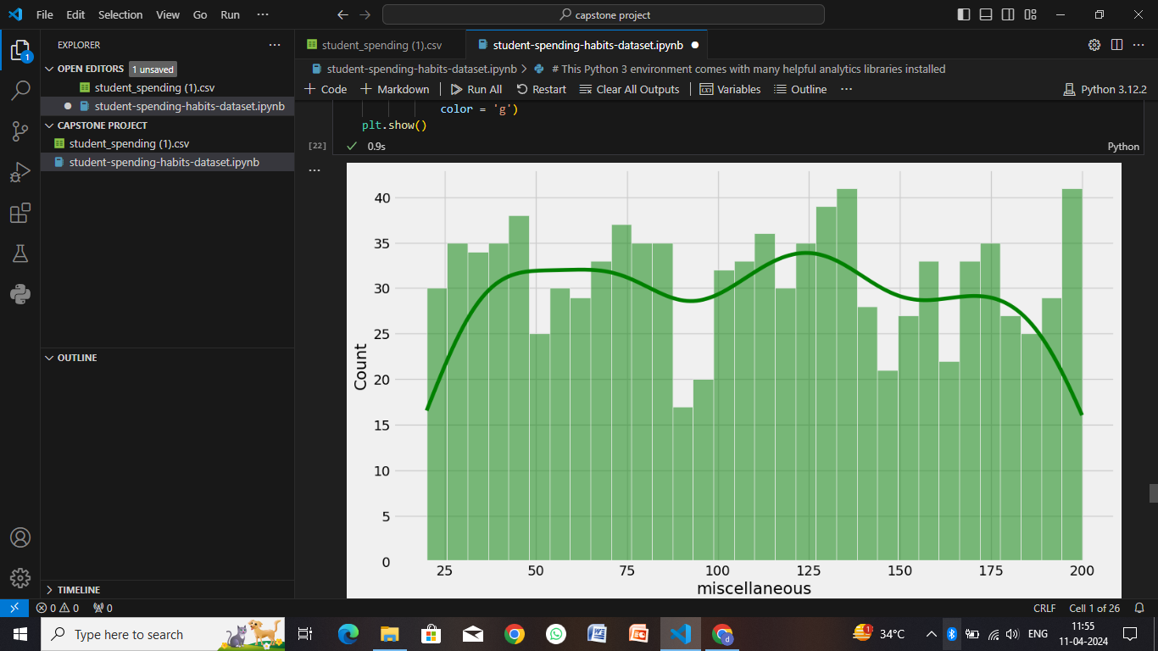
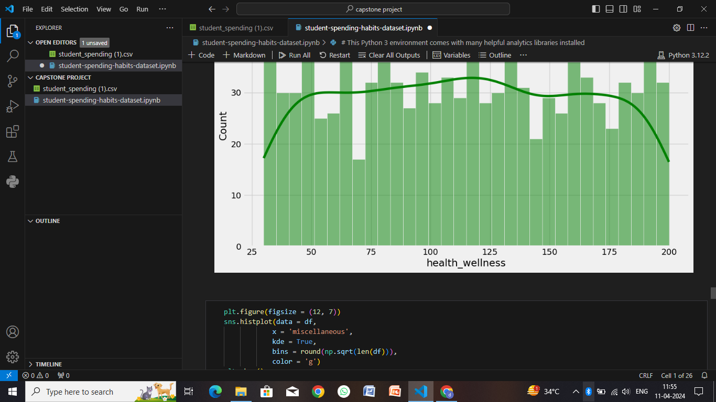
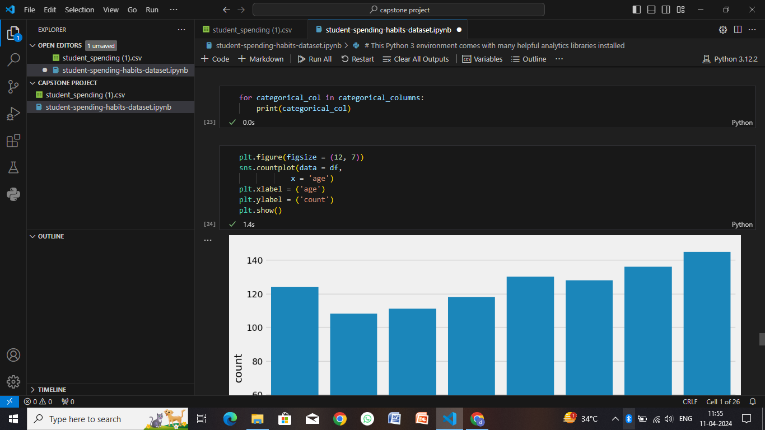
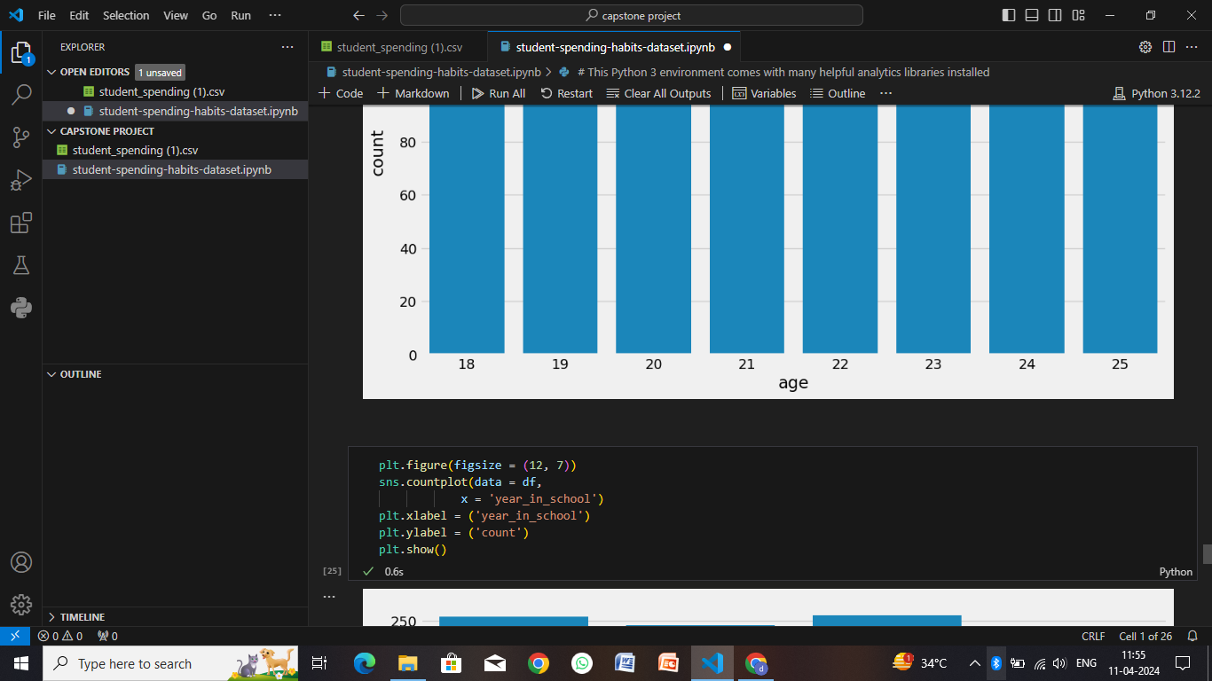

Slide 14
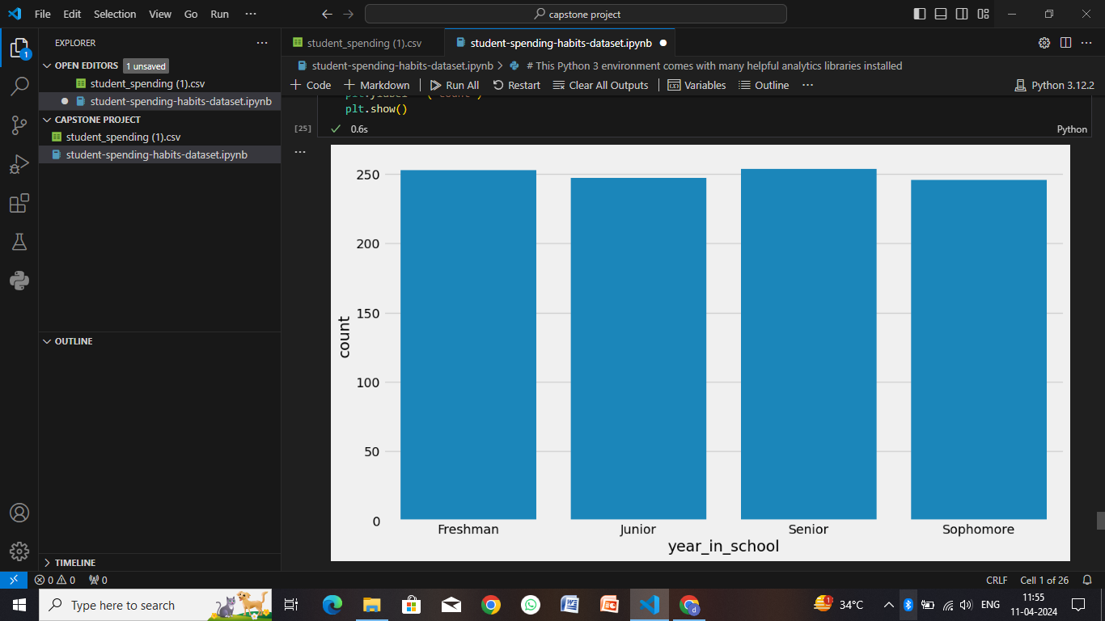
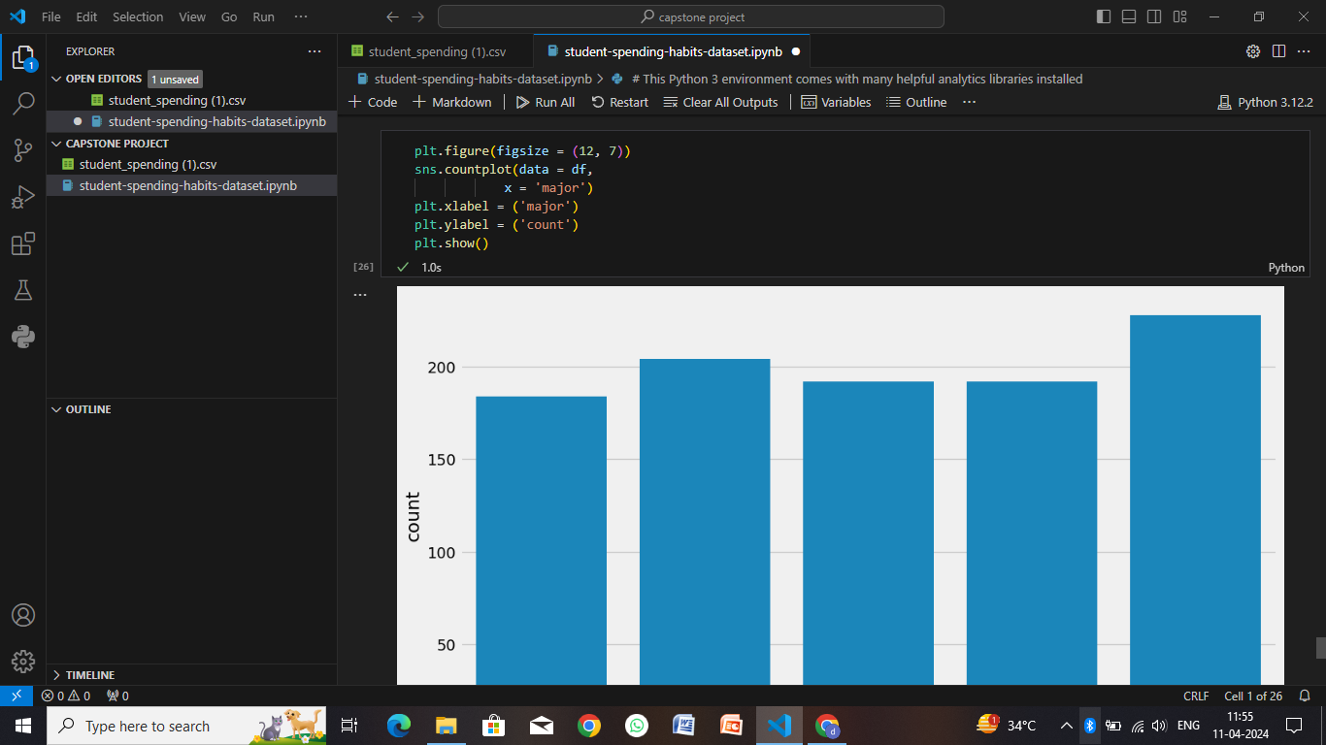
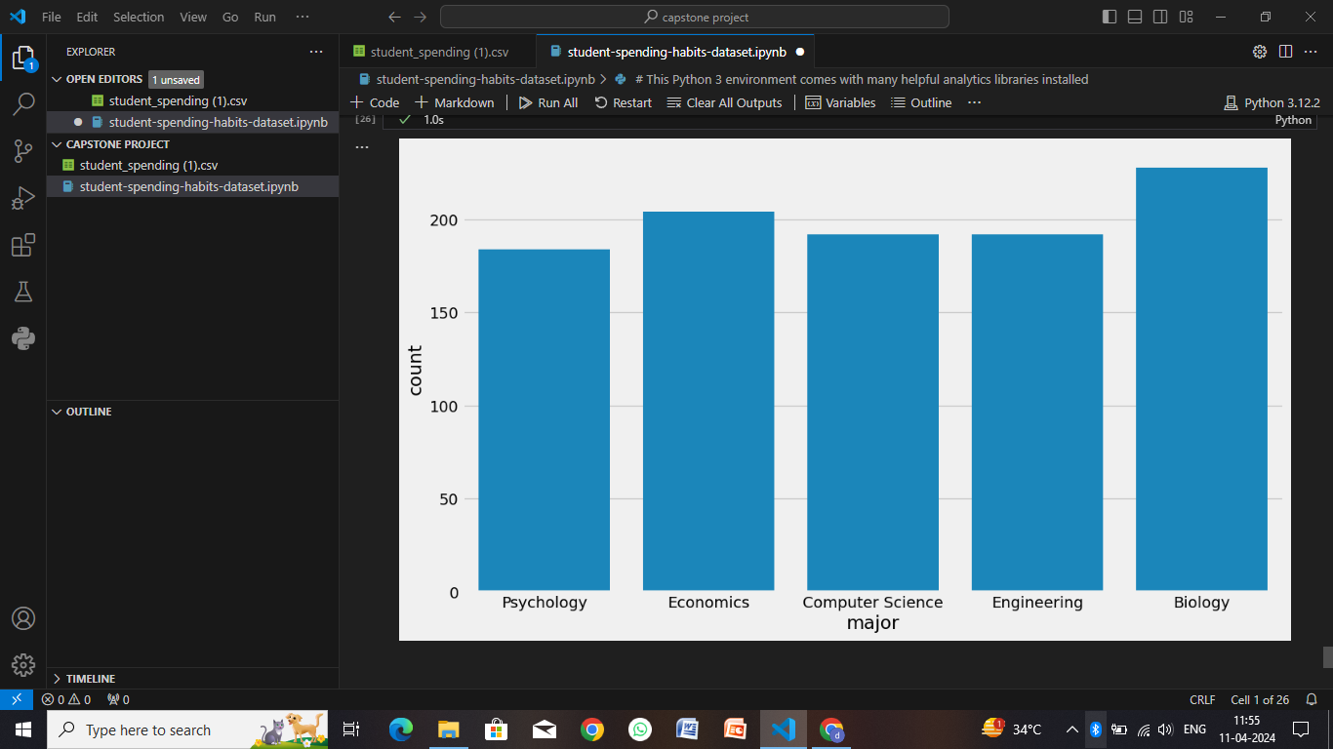

Slide 15
Conclusion
Diverse Priorities: Students have diverse spending priorities based on their individual circumstances, including tuition, housing, food, transportation, entertainment, and personal expenses.
Budgeting Challenges: Many students face challenges in budgeting due to limited income from part-time jobs or allowances, leading to a need for financial literacy education and tools to manage money effectively.
Technology Impact: The rise of technology has influenced spending habits, with students often allocating funds for digital subscriptions, gadgets, and online services, alongside traditional expenses.
Social and Peer Influences: Peer pressure and social influences play a significant role in student spending, affecting choices related to fashion, socializing, dining out, and leisure activities.
Debt and Financial Stress: Some students may resort to loans, credit cards, or overdrafts to cover expenses, leading to financial stress and long-term debt if not managed responsibly.
Changing Trends: Economic conditions, cultural shifts, and educational trends can impact student spending habits over time, influencing patterns related to saving, investing, and consumption.

Slide 16
Future scope
The future scope of studying student spending habits holds significant potential for various stakeholders, including researchers, educators, policymakers, and financial institutions. Here are some areas of focus and potential developments
Technology Integration: As technology continues to evolve, there's an opportunity to integrate financial management tools directly into educational platforms. This can include budgeting apps, financial literacy courses, and real-time spending analysis tools tailored to students' needs.
Data Analytics: Leveraging big data and analytics can provide deeper insights into student spending patterns. This can help identify trends, predict future financial behaviors, and offer personalized recommendations for budgeting and saving.
Behavioral Economics: Applying behavioral economics principles can lead to innovative interventions to encourage responsible spending among students. Nudges, incentives, and gamification techniques can promote positive financial habits and discourage impulsive spending.
Financial Education Initiatives: Collaborative efforts between educational institutions, government agencies, and financial organizations can expand financial education programs. These initiatives can cover topics such as budgeting, debt management, investment basics, and financial planning for students.
Sustainable and Ethical Spending: With growing awareness of sustainability and ethical consumerism, there's a potential shift in student spending habits towards environmentally friendly and socially responsible choices. Research in this area can explore the intersection of financial decisions and ethical considerations.

Slide 17
References
The Financial Lives of College Students: A National Study of Student Financial Wellness" by Aaron Anthony Godin, Sara Goldrick-Rab, and Daniel Douglas Huttel. This study explores the financial challenges faced by college students and their impact on overall well-being.
Trends in Student Aid" by The College Board. This annual report provides data and analysis on trends in student financial aid, including grants, loans, and work-study programs.
Financial Literacy and Financial Behavior Among Young Adults: Evidence and Implications" by Annamaria Lusardi and Olivia S. Mitchell. This research paper delves into the relationship between financial literacy, behavior, and outcomes among young adults, including college students.
Understanding College Students’ Spending Practices: An Analysis of the Effects of Financial Literacy and Financial Satisfaction" by Sara B. Marcketti and Elena Karpova. This study examines the factors influencing college students' spending habits, including their level of financial literacy and satisfaction.
Money Matters: Financial Stress and Student Achievement" by Emily G. Adams, Sarah M. K. Grogan, and Andrea B. Lee. This research investigates the impact of financial stress on students' academic performance and overall well-being.
Millennial Money Mindset Report" by TD Bank. This report provides insights into the financial behaviors and attitudes of millennials, including college students, regarding budgeting, saving, and spending.
The Impact of COVID-19 on College Student Finances" by Sallie Mae. This report discusses the financial challenges faced by college students during the COVID-19 pandemic, including changes in spending habits and financial priorities.

Slide 18
THANK YOU

